Slide 1
Scalable Blocking for Privacy Preserving Record Linkage Presented at ACM SIGKDD 2015
Alexandros Karakasidis^{1*}, Georgia Koloniari²
and Vassilios S. Verykios³
¹Department of Computer Science University of Cyprus Nicosia, Cyprus akarakasidis@cs.ucy.ac.cy | ² Department of Applied Informatics University of Macedonia Thessaloniki, Greece gkoloniari@uom.gr
³School of Science and Technology Hellenic Open University Patras, Greece verykios@eap.gr
*Work completed while author was at Hellenic Open University

Slide 2
Presentation outline
Introduction to privacy preserving record linkage
Scalable blocking for privacy preserving record linkage
Research plans within iSocial

Slide 3
Presentation outline
Introduction to privacy preserving record linkage
Scalable blocking for privacy preserving record linkage
Research plans within iSocial

Slide 4
Introductory Example Application
A medical researcher who wants to investigate the possible side effects of a new medicine.
Αccess data across different hospitals doctors and pharmacies.
Identify patients prescribed the medicine, symptoms, treatments.

Slide 5
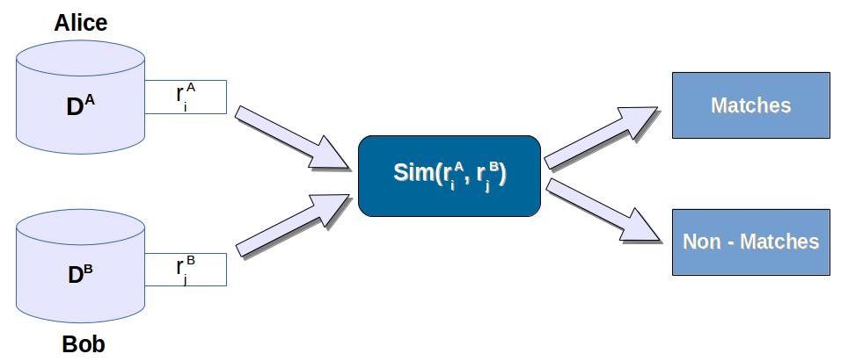
The privacy preserving record linkage problem
No unique identifier to determine common data.
Low quality data requires approximate matching methods.
Only information of matched records is revealed.

Slide 6
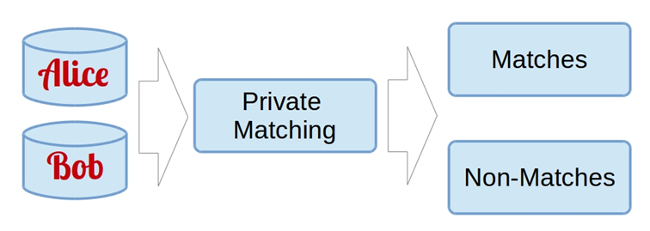
Privacy preserving record linkage phases
Private matching
Elaborate all-to-all comparisons between:
Corrsponding fields in records, or
Entire records.
Computationally expensive distance functions.
Large volumes of data.
Concern: privacy of individuals described by data.

Slide 7
Privacy preserving record linkage phases
Private blocking
Aims at reducing the matching complexity of private matching.
Organizes likely to match candidate records into blocks.
Reduces recall.
Only records within the same block are matched.

Slide 8
Privacy preserving record linkage phases
Private meta-blocking
Further reduces matching complexity.
Reorganizes the way records are matched within a block.

Slide 9
Related Work
Private matching
Embedding spaces (M. Scannapieco, ACM SIGMOD, 2007).
Reference set matching (C. Pang et al., Intel. Patient Manag. 2009).
Bloom bigrams (R. Schnell et al., BMC Med. Inform. and Decision Making).
Private blocking
Simple blocking (A. Al-Lawati et al., IQIS, 2005).
Value generalization hierarchies (A. Inan et al, IEEE ICDE, 2008).
Two-party private blocking (D. Vatsalan et al., ACM CIKM, 2013).
Private meta-blocking
Sorted neighborhood for encrypted fields (A. Karakasidis and V. S. Verykios, IEEE ICDMW 2012).

Slide 10
Presentation outline
Introduction to privacy preserving record linkage
Scalable blocking for privacy preserving record linkage
Research plans within iSocial

Slide 11
Our Approach
Blocking techniques trade off privacy or result quality to speed up matching.
Our idea:
Introduce redundancy, in the blocking process, to improve both recall and fault tolerance, while keeping complexity low.

Slide 12
Our Approach
We propose Multi-Sampling Transitive Closure for Encrypted Fields (MS-TCEF):
Derives multiple assignments of records to blocks.
May be combined with meta-blocking techniques to further reduce privacy preserving record linkage complexity.

Slide 13
Contributions
Linear execution time with respect to dataset size.
Linear privacy preserving record linkage when combined with privacy preserving meta-blocking.
Theoretical complexity analysis supported by extensive experimental evaluation.

Slide 14
Key Points
Reference Set
Fast Classification
Multi-Sampling
Transitive Closure for Encrypted Fields

Slide 15
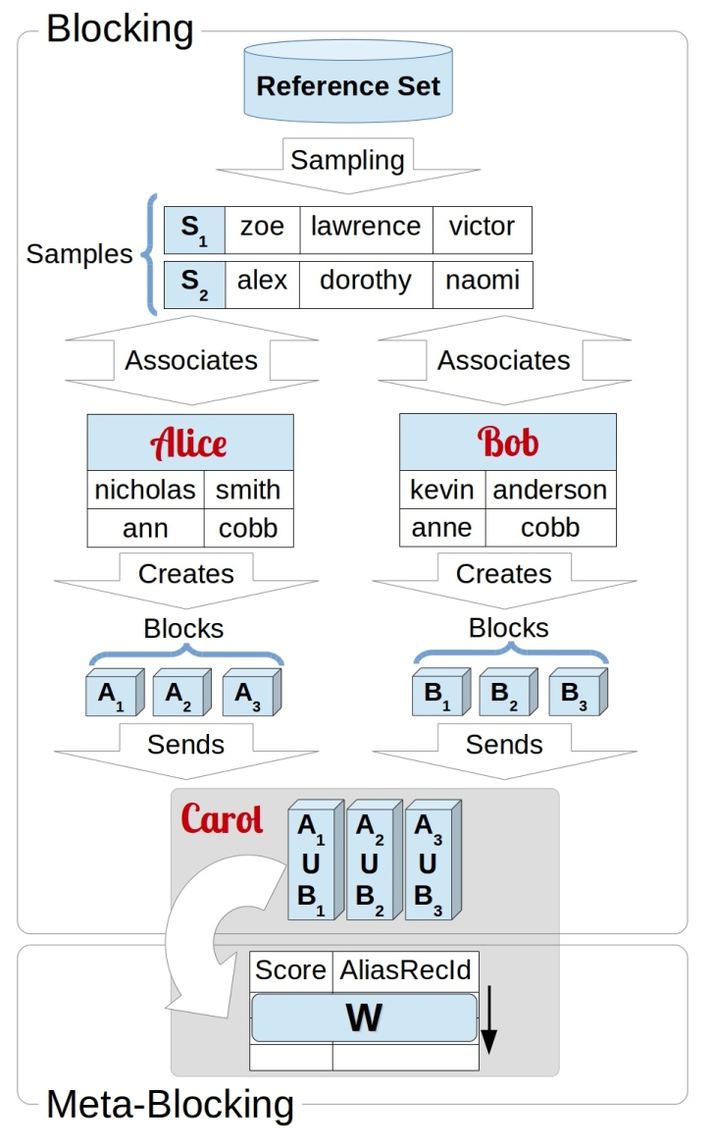
Reference Set
Dataset either derived from publicly available databases or synthetically generated.
Used as an intermediate point of comparison.
Relate Αlice’s and Bob’s data to the Reference Set.
Intuition
If two objects are similar to a third one, then, they are more likely to be similar to each other as well.

Slide 16
Fast Classification
Each reference value is considered as a separate class.
Records are classified by associating blocking attributes with closest reference values.
Reference values are lexicographically sorted.
Binary search over reference values.
Edit distance calculation
Records with similar attributes fall within the same class.

Slide 17
Multi-Sampling
Repeat classification with multiple, different reference set samples, so as to attain multiple class assignments.
Samples generated using Durstenfeld shuffle.
Intuition
Use redundancy to compensate for misclassifications.
Errors occurring with one assignment may be corrected by another.

Slide 18
Transitive Closure for Encrypted Fields
Each record is assigned to a block based on the class assignments of its blocking attributes.
When more than three, blocking attributes are considered in overlapping pairs.
Blocks contain aliases of the record ids, so that no plaintext information is revealed.
Advantage
By not combining all blocking attributes together we derive multiple block assignments for each record and increase fault tolerance.

Slide 19
Transitive Closure for Encrypted Fields
_{Blocking attributes}
b₁ | b₂ | b₃ | b₄
Plain combination
b1∩b2∩b3∩b4
Transitive closure
b1∩b2, b2∩b3, b3∩b4, b4∩b1
Each record is assigned to a block based on the class assignments of its blocking attributes.
Blocking attributes are considered in overlapping pairs.
Blocks contain aliases of the record ids, so that no plaintext information is revealed.
Advantage
Increased fault tolerance due to multiple block assignments

Slide 20
Combination with meta-blocking
Sorted neighborhood for encrypted fields.
A score function gives each record a score using blocking attribute distances from a reference set.
Uses a sliding window to avoid all-to-all matching within blocks.
Intuition
Records within the same window having close scores are more likely to match.

Slide 21
Information leakage
Alice and Bob know
Carol knows
Public reference set
Number of blocks
Number of blocks.
The number of records in each block.
With SNEF metablocking: the score of each record.

Slide 22
Time complexity
Private blocking
Privacy preserving
record linkage
S: number of reference set samples,
b: number of blocking attributes,
|r|: dataset size,
|RS|: size of a reference set sample,
w: size of SNEF's window.

Slide 23
Experimental results

Slide 24
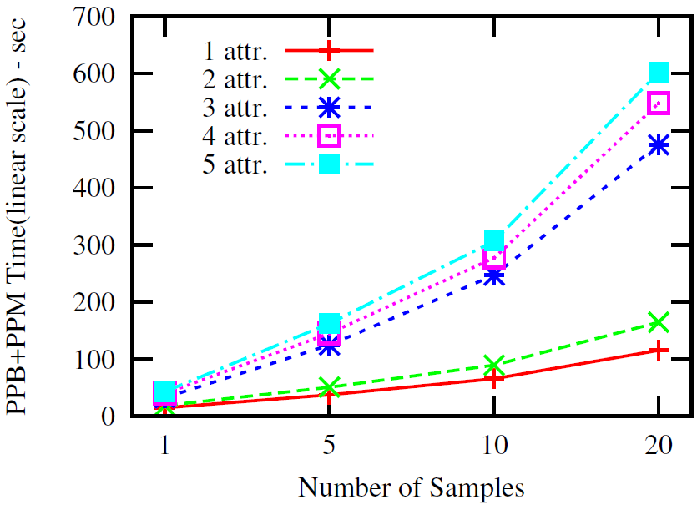
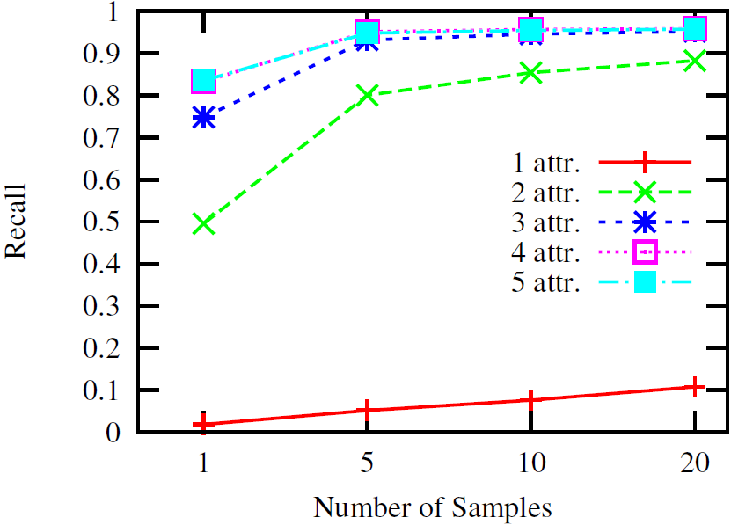
Attributes w.r.t. samples
Using multi-sampling increases recall even when the number of available blocking attributes is small.

Slide 25
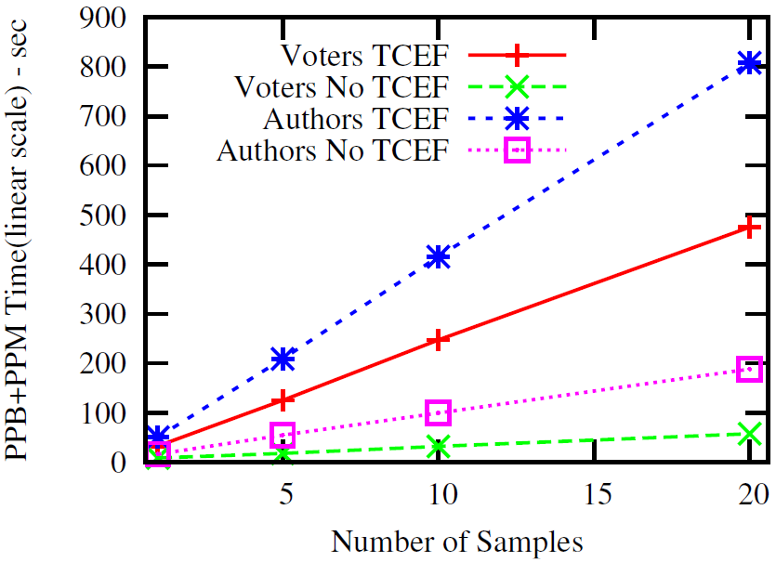
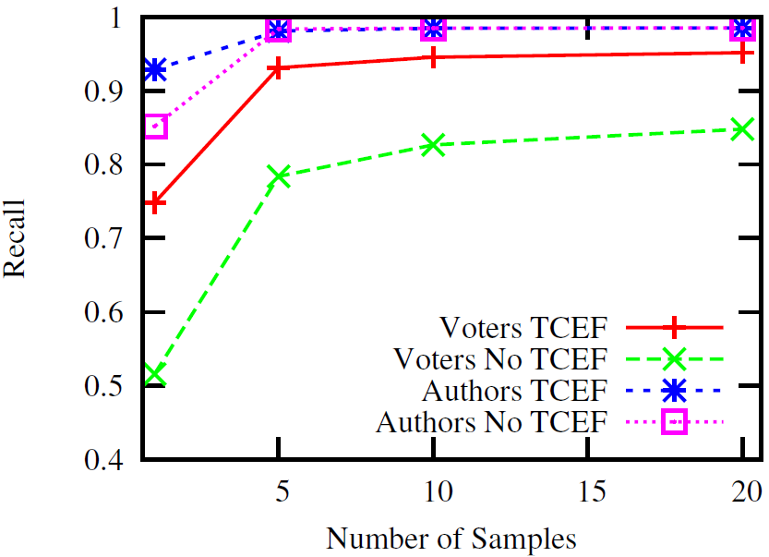
TCEF Impact
While TCEF increases processing cost, it improves recall up to 45% and copes successfully with dirty data.

Slide 26
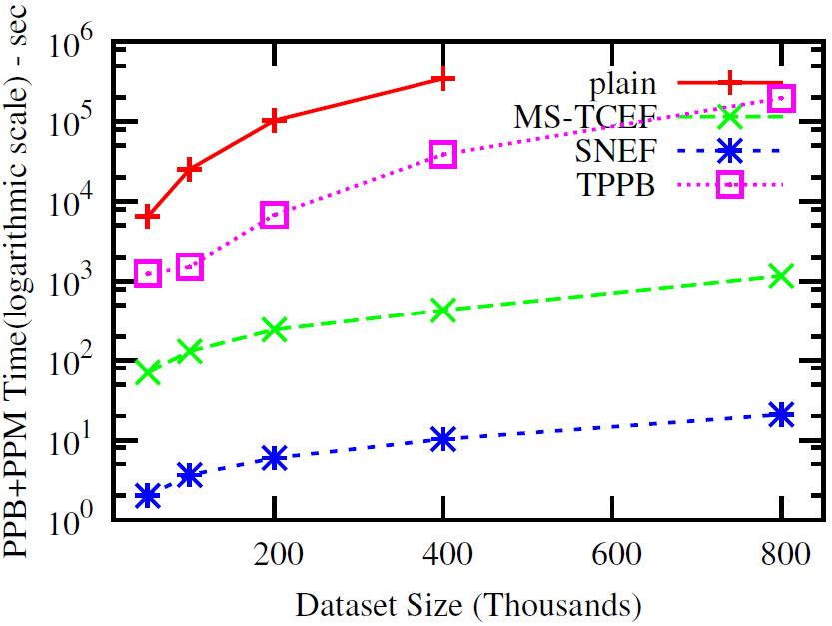
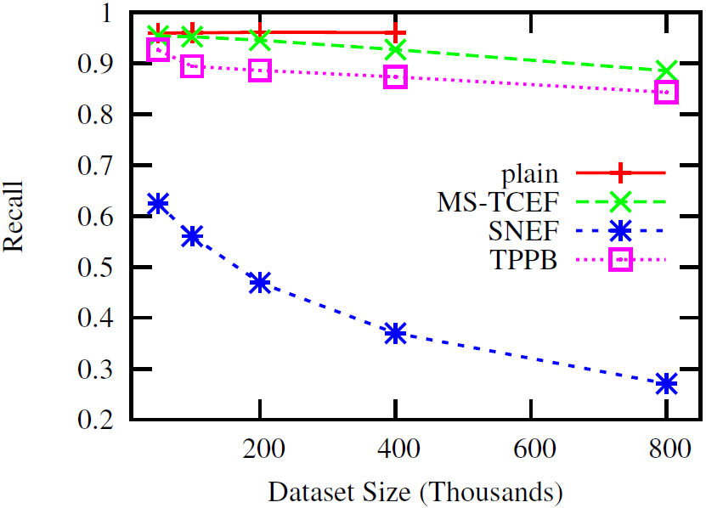
Time complexity
Linear to dataset size.
Compared to state of the art methods (two party private blocking (TPPB) and sorted neighborhood for encrypted fields (SNEF)), MS-TCEF is faster and achieves higher recall.

Slide 27
Summary
Multi-Sampling Transitive Closure for Encrypted Fields: a highly scalable privacy preserving blocking method.
Exploits redundancy for achieving high result quality and effectively dealing with dirty data.
Based on the use of multiple reference set samples and multiple record to block assignments.
Linear to the dataset size.
Turns the whole privacy preserving record linkage process into linear w.r.t. time when combined with meta-blocking.
Outperforms existing state-of-the-art methods.
High performance both in terms of matching accuracy and execution time.

Slide 28
Presentation outline
Introduction to privacy preserving record linkage
Scalable blocking for privacy preserving record linkage
Research plans within iSocial

Slide 29
Research plans within iSocial
Hiding user locations in social networks
Wavelets for regulating feeds in social networks
Postings from specific locations at particular time moments reveal users' preferences, compromising their privacy.
We aim at hiding this information, maintaining, at the same time, high data usability.
Feeds in social networks provide users with large volumes of information.
We consider modelling each feed as a stream and using wavelets for redicing information overload.

Slide 30
Hiding user locations in social networks
Replace a user's location with one of k points of interest.
Geographical. The location is replaced with a reference to the coordinates of a nearby point of interest.
Semantic. The location is replaced with a nearby location of the same type (e.g. another coffee shop).
Intuition:
Instead of explicitly defining the location of a user, we will use a reference to a (nearby) Point Of Interest (POI).

Slide 31
Wavelets for regulating feeds in social networks
Intuition:
Reduce information overload by modelling each feed as a stream, pruning out ‘less important’ information.
Aim:
Reveal tendencies and regulate excessive flow of information from a specific source.
Convert data in such a stream to numerical values
using TF/IDF
using metrics of previous activity on similar feeds, such as clicks, shares (e.g. retweets), likes etc.
Use a stream ’s wavelet, representation to regulate the flow.
Explore application to other fields, e.g. IoT.

Slide 32
Thank you for your attention

Slide 33
Support Slides

Slide 34
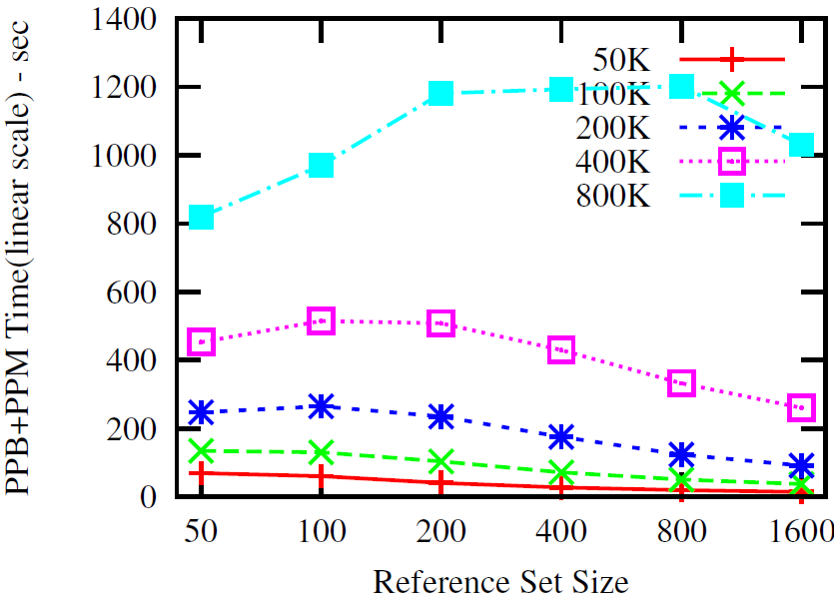
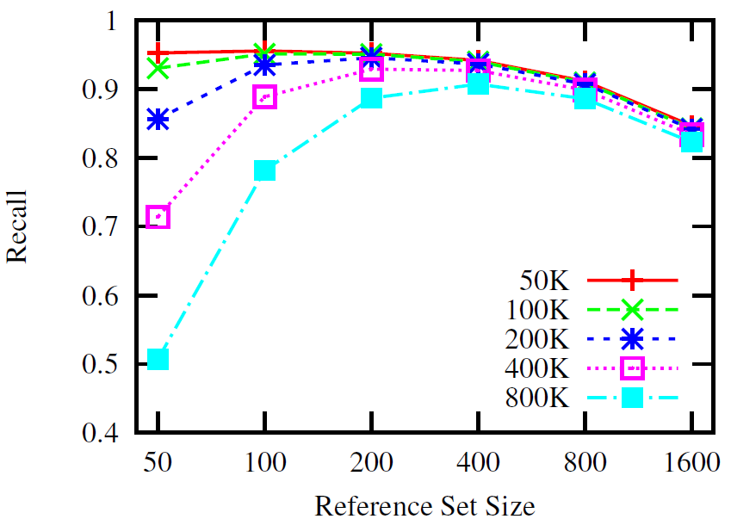
Experimental results
Reference set size

Slide 35
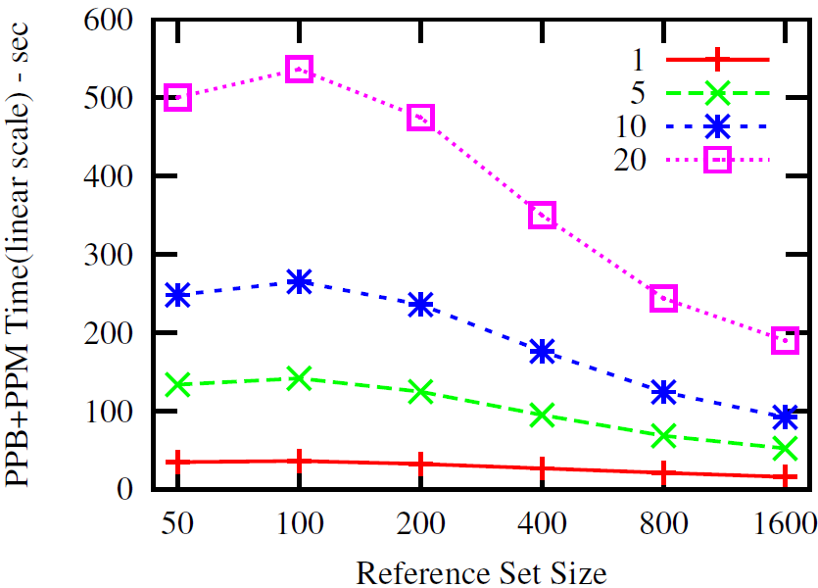
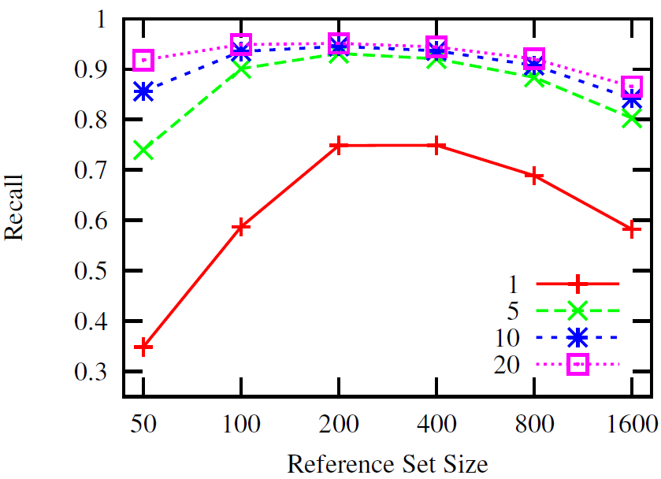
Experimental results
Reference set size w.r.t. to samples (voters)

Slide 36
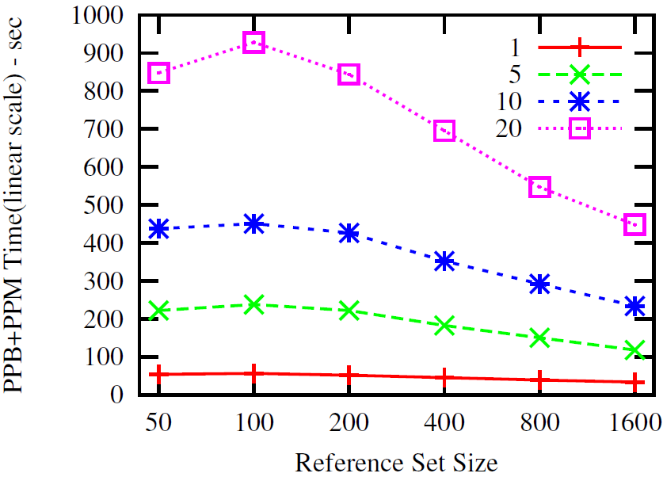
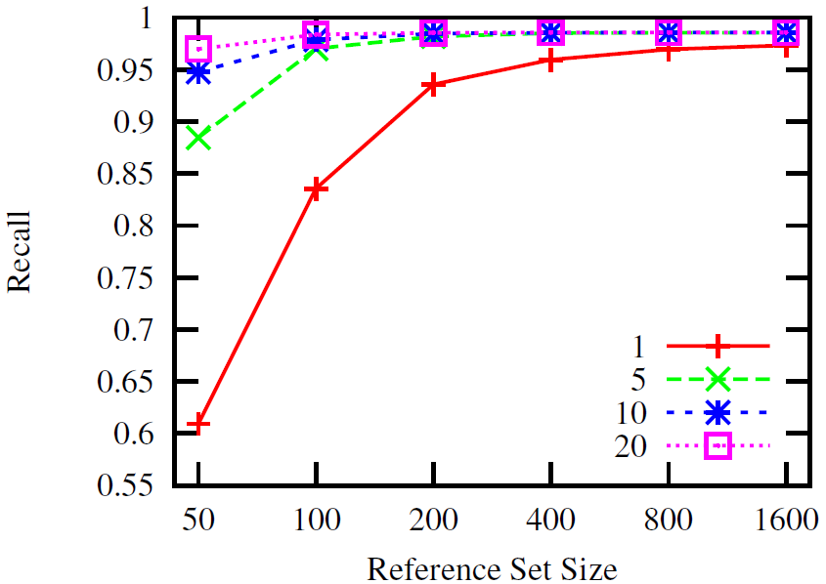
Experimental results
Reference set size w.r.t. to samples (authors)

Slide 37
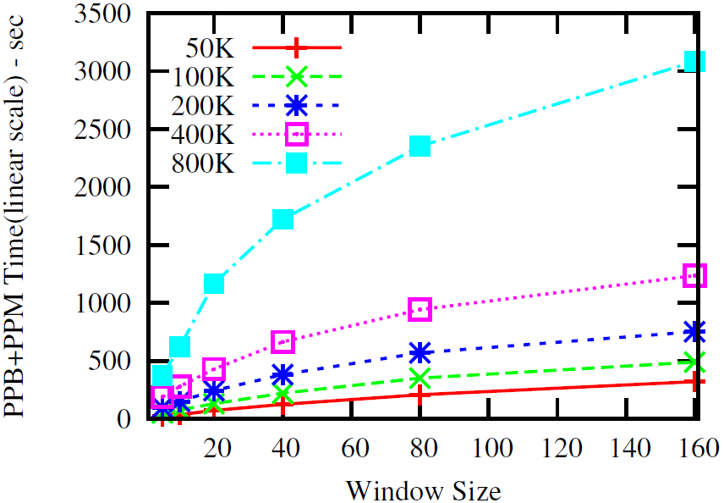
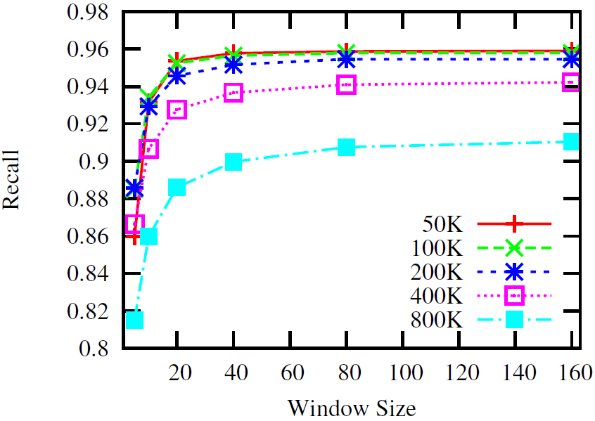
Experimental results
Window size

Slide 38
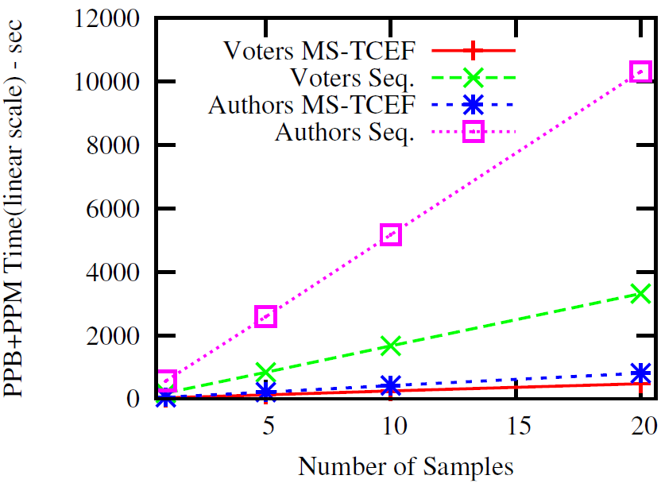
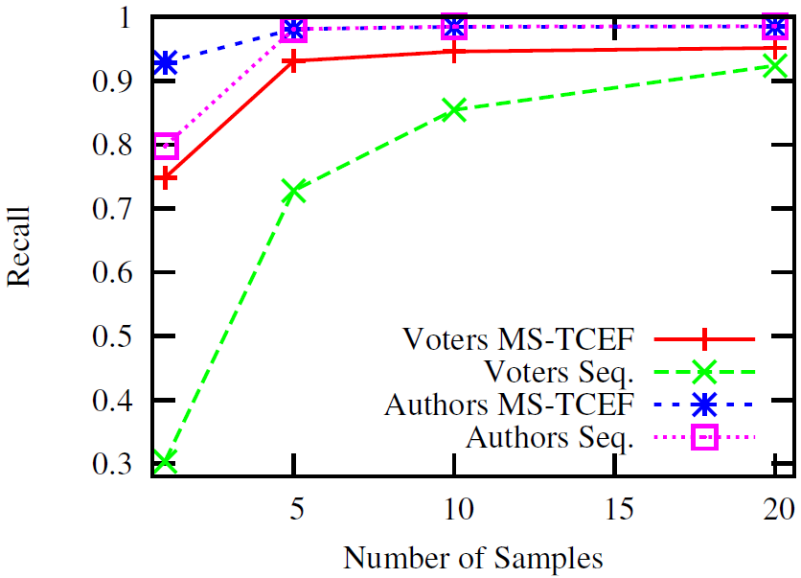
Experimental results
Classification

