Slide 1
DLSAS: Distributed Large Scale Anti-Spam for DOSNs
Amira Soliman
iSocial meeting, Italy
28-29 January 2016

Slide 2
Outline
Spam detection mechanisms.
DOSNs, why is it different?
DLSAS.
Future extensions.

Slide 3
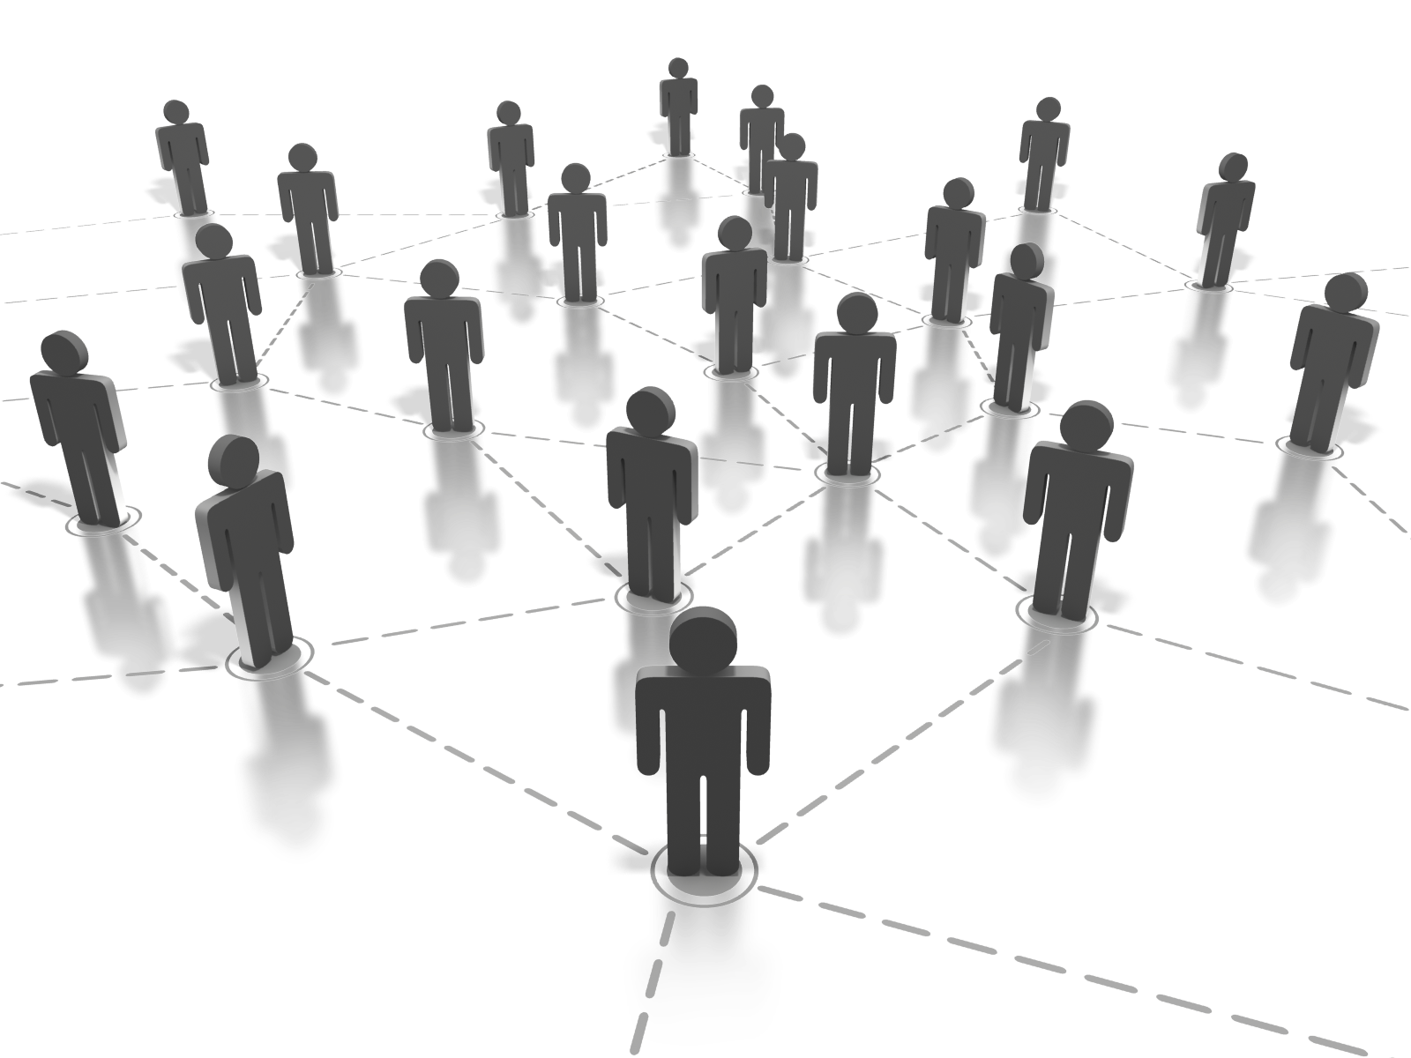
Online Identities [OSNs]
Complete Freedom:
Preserve users’ privacy / anonymity.
In practice, many users provide offline identities.
Yet, they have Achilles heel:
Users operate behind weak identities.
Honest users are Vulnerable to different attacks (i.e., Sybil, Malware, and Spam)
Notes:
Mention some examples of famous OSNs attacks
Fake Apps: install malware and post updates on a user’s newsfeed, spreading the attack. DISLIKE button example.
Spam: Spoofed URLs that looks like original web sites, even it becomes harder with the shortened urls.

Slide 4
How to Spot Malicious content?
OSNs Providers
- Report
- URL Blacklisting
Graph Analysis
- Users
- URLs
Content Analysis
Hybrid
Notes:
OSNs Providers: report and having many URLS in a post/message. Analyzing URLs and Javascript in new apps.

Slide 5
Spam Detection: State-of-the art
Graph Analysis
Analyzing spammers' social networks for fun and profit [WWW’12]
UNIK: Social Network Spam Detection [CIKM’13]
Detecting and Characterizing Social Spam Campaigns [SIGCOMM’10]

Slide 6
Spam Detection: State-of-the art
Hybrid: Network + Content Analysis
Discovering Spammers in Social Networks [AAAI’12]
Empirical Evaluation and New Design for Fighting Evolving Twitter Spammers [IFS’13]

Slide 7
What’s In?
Offline
Signature-based Detection
What’s missed Out?
Real-time
Flexibility and Adaptation

Slide 8
DOSNs: new challenges
Malicious nodes are integrated in the system: misbehave while pretending to be good.
Central authority does not exist: no misbehavior reporting.
Nodes are restricted by the limited knowledge they have: collaborative work is a must.
Distributed machine learning algorithms can not be directly applied: sample bias.

Slide 9
Distributed Machine Learning
T
Shard T into S Pieces T= {T₁, T₂, .. , T_{s}}
W^{(i)} = TrainModel(T_{i})
W =
T₁
T₂
T₃
μ_{i} is the fraction of data for piece i

Slide 10
DOSNs: The Wisdom of The Crowds
DIVa: Topological Overlay.
DLSAS: Random Overlay(s).

Slide 11
DLSAS: Distributed Large Scale Anti-Spam
No a priori knowledge is required.
Hybrid features:
Content-based features:
Calculating ratio of Similarity, spam words, URLs, Hashtags, and Mentions.
Network-based features:
IN to OUT degree
Gossip Learning: adopt ensemble learning using gossip-based peer sampling.
Validation overlays: detecting misbehaving nodes and disconnecting them.
Unsupervised Learning
“CLUSTERING”
Gossip-based
Peer Sampling
Gossip-based
Validation Overlay
Main Components

Slide 12
Unsupervised Learning
Clustering:
Distinguish spammers from normal users,
Learn locally,
Exchange only a subset to reach the global solution.
K-means algorithm

Slide 13
Gossip-based Peer Sampling
D
H
L
M
Friendship
Graph
B
E
I
K
N
G
O
A
F
J
C
D
L
I
L
B
J
B
J
H
K
H
E
M
A
…..
M
A
O
F
O
E
I
F
K
D
Random
Overlays
C
N
C
G
N
G

Slide 14
Spotting Misbehaving Nodes
Validation overlay:
Nodes’ data are reproducible,
Auditors are randomly selected,
Features are randomly assigned to auditors.
Decision is based on validation of node’s model versus Auditors’ model.
Learning Overlay
Social Graph
Validation Overlay

Slide 15
Spammer’s Behavior
Spammers may
Communicate “normal” results as a cover.
Corrupt learning by injecting outliers:
Random outliers
Cluster centroids
Validation overlay forces spammers to mimic normal users
= Win

Slide 16
Results

Slide 17
Future Extensions
Incremental Learning: updating behavior clusters over time.
Detecting Spam Campaigns: correlating spam signatures on the two levels of network connectivity and content similarity.
Spam Detection: integrating other detection techniques (DIVa)

Slide 18
Thanks
DLSAS: Distributed Large Scale Anti-Spam
Q & A

