Slide 1
Distributed Publish/Subscribe Notification System for Online Social Networks
Stefanos Antaris*, Sarunas Girdzijauskas†
George Pallis*, Marios Dikaiakos*
*University of Cyprus, †Hive Streaming AB
*{antaris.stefanos, gpallis, mdd}@cs.ucy.ac.cy
†sarunasg@kth.se
iSocial Meeting, Milan, Italy
January 28th 2016

Slide 2
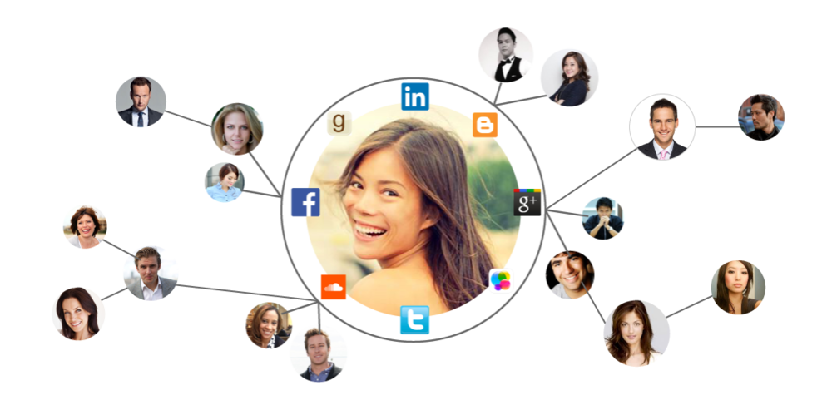





Introduction
  Large-scale Notification System
    Social friend‘s posts
    Interested groups
    Advertisement
Online Social Network
  Cloud-Based Solution (Brokers)
    Bounded scalability
    Thousands of resources
    Cloud providers dependency
    Privacy issues
Pub/Sub System
Publishers
Subscriber

Slide 3
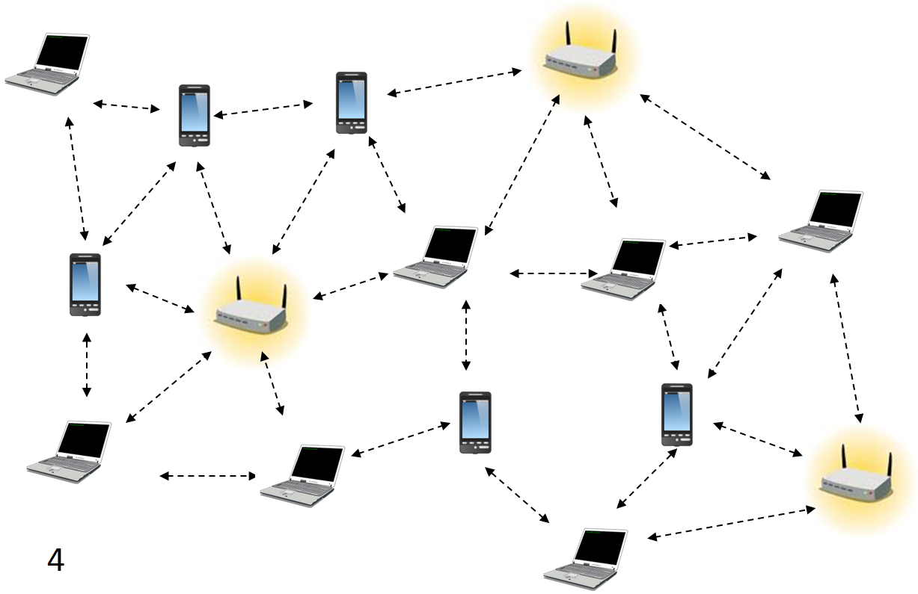
Introduction
  Large-scale Notification System
    Social friend‘s posts
    Interested groups
    Advertisement
Social Network
  P2P Solution
    Unbounded scalability
    Reliability
    Data ownership
    Topology inconsistency
    Additional hops
    Relay Nodes
    Network latency
P2P Network

Slide 4
Research Question
“Is it possible to design a Publish/Subscribe Notification System over a P2P substrate that incorporates the structural properties of the social network in order to reduce the number of hops and the number of relay nodes for a Social Network?”

Slide 5
Contribution
Design and implement a novel P2P overlay network
  Leverage the social graph in the construction of the topology
  Establish direct connections on social friends
Apply on a real-life NewsFeed service
Evaluate against state-of-the-art approaches
  83% number of relay nodes reduction
  56% number of hops reduction

Slide 6
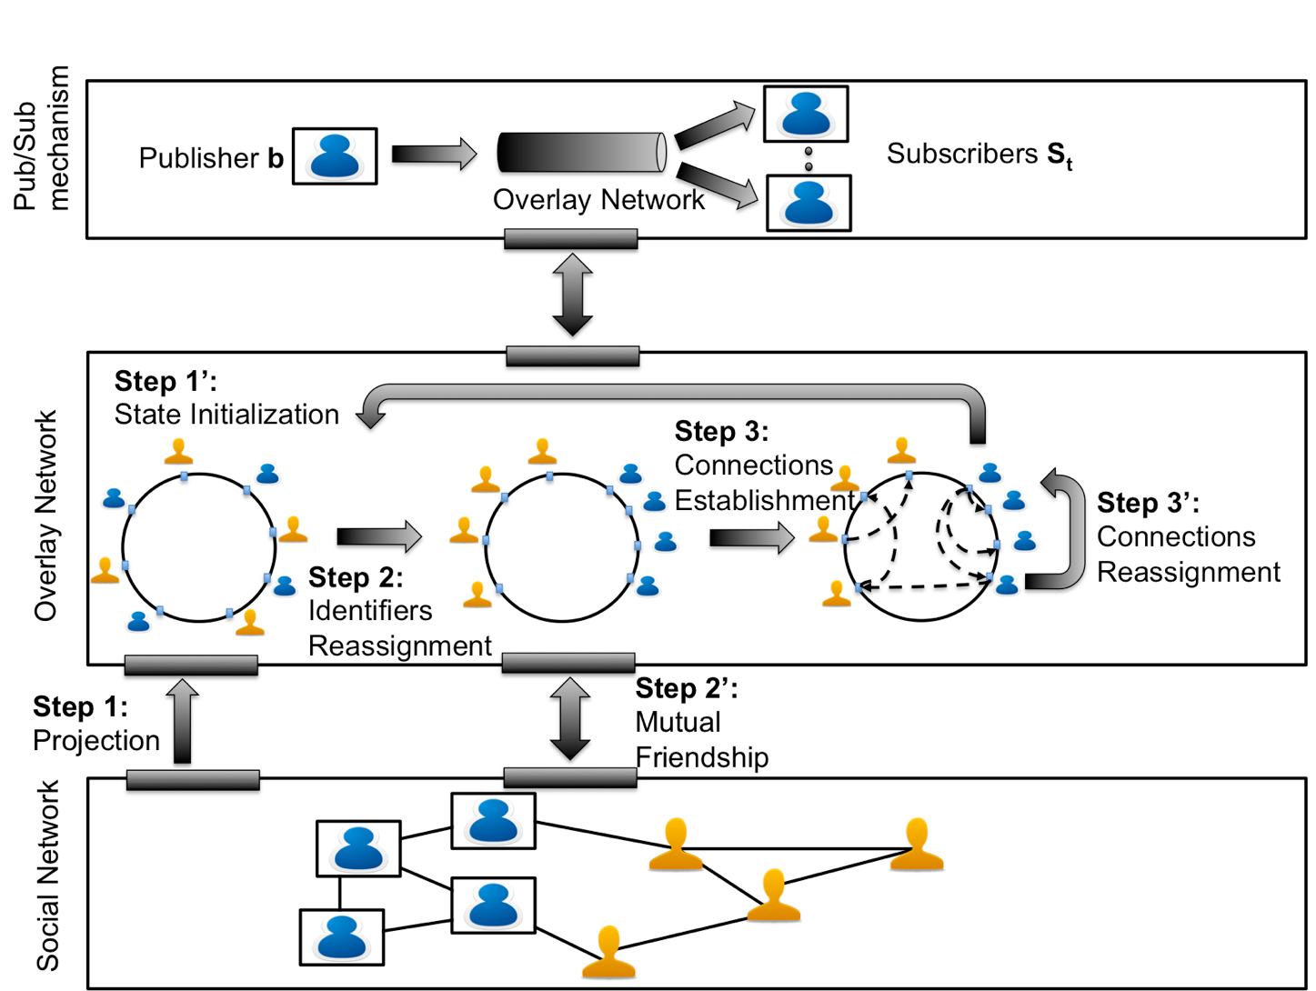
System Model

Slide 7
Step 1 : Projection
Each social user participates as one peer in the P2P overlay network
Social Network
NodeIDs assigned using uniform hash function
P2P Network

Slide 8
Step 1’ : State Initialization
Each social user participates as one peer in the P2P overlay network
Social Network
NodeIDs assigned using uniform hash function
Peer State
NodeID 123
Social Neighbors IDs
112
134
101
P2P Network
Routing Table
214
102
…
114

Slide 9


Social Friendship Request
Alice sends friend request to Bob
Step 1
Bob and Alice still needs logN hops to communicate
N=10⁶ , logN = 5
Social Network
Peer 112 looks up peer 123
Step 2
Bob accepts friend request
Step 3
P2P Network
Both update their Social Neighbors table
Step 4
Social Neighbors IDs
123
…
…
Social Neighbors IDs
112
…
…

Slide 10
NewsFeed Service
Alice identifies Social Neighbors’ Node IDs
Step 1
Social Neighbors IDs
123
334
…
Social Network
NewsFeed service requires
dlogN messages
N=10⁹ , logN = 7
d = 3000, # of messages = 21000
Alice sends message to Bob
Step 2
Alice sends message to Trudy
P2P Network
Step 3

Slide 11
System Model

Slide 12
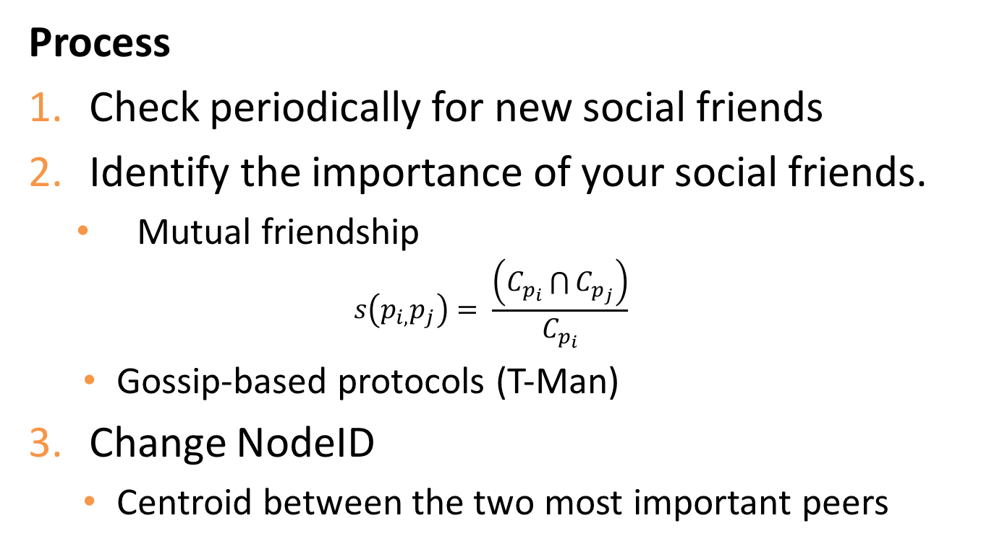
Step 2 : Identifier Reassignment
Process
Check periodically for new social friends
Identify the importance of your social friends.
  Mutual friendship
            $$s\left(p_{i,}p_{j}\right)= \frac{\left(C_{p_{i}}\bigcap{C_{p_{j}}}\right)}{C_{p_{i}}}$$
  Gossip-based protocols (T-Man)
Change NodeID
  Centroid between the two most important peers

Slide 13
System Model

Slide 14
Step 3: Connections Establishment
Assumptions for selecting social friends as P2P connections
  Social users communicate mostly with their social friends
  Most important social friends in close distance in the P2P overlay
    NodeID reassignment process
  Mutual friendship reduces the number of relay nodes

Slide 15
Step 3: Connections Establishment
K connections per peer
  If C < K
    K social connections
    |C| - K random connections (overall network)
Connection policies tested on K
  Policy 1 : 20% most important friends, 80% less important friends
  Policy 2 : 80% most important friends, 20% less important friends
  Policy 3 : 50% most important friends, 50% less important friends
  Policy 4 : 50% most important friends, 50% random friends
  Policy 5 : 80% most important friends, 20% random friends
  Policy 6 : all random friends

Slide 16
Routing Table Construction
All policies improve only a subset of the network

Slide 17
Step 3: Connections Establishment
Process
Select K most important social friends
Periodically acquires social neighbor’s P2P connections
  Retrieve bitmaps
  Gossip-based protocol (T-Man)
Apply LSH on bitmaps
  Bitmaps are indexed in B buckets
  Explore P2P connection similarities
  Socially-connected peers maintain similar P2P connections.
Select one peer from each bucket
  Ensures that K connections maintain the minimum overlap

Slide 18
Evaluation
Data Set | Users | Connections | Average Degree
Facebook [1] | 63,731 | 817,090 | 25.642
Twitter | 3,990,418 | 294,865,207 | 73.89
Slashdot [2] | 82,168 | 948,463 | 11.543
GooglePlus [2] | 107,614 | 13,673,453 | 127
NewsFeed simulation:
Data generation rate: exponential distribution [3]
Information diffusion: users propagate their posts to their social friends independently
Simulation parameters:
Data Sets with different characteristics
Node registration rate: exponential distribution [3]
Number of trials: 100 independent simulations
Discrete event simulator: Apache Flink, Gelly Graph API
[1] B. Viswanath, et al., “On the evolution of user interaction in facebook”, WOSN, 2009
[2] Stanford large network dataset collection”, http://snap.stanford.edu, accessed Jul. 02, 2015
^{[3]} K. Zhu, et al., “Modelling population growth in online social networks”, Complex Adaptive Modelling, 2013

Slide 19
Evaluation
Data Set | Users | Connections | Average Degree
Facebook [1] | 63,731 | 817,090 | 25.642
Twitter | 3,990,418 | 294,865,207 | 73.89
Slashdot [2] | 82,168 | 948,463 | 11.543
GooglePlus [2] | 107,614 | 13,673,453 | 127
Evaluation metrics used:
Number of Hops: The P2P hops required to communicate two social friends
Number of Relay Nodes: The number of relay nodes exists in the pub/sub
Number of iterations: The number of iterations required to converge
State-Of-The-Art comparison:
Symphony: No social friendship augmentation
Nasir et al[3]: Chord overlay network with node identifier reassignment
[1] B. Viswanath, et al., “On the evolution of user interaction in facebook”, WOSN, 2009
[2] Stanford large network dataset collection”, http://snap.stanford.edu, accessed Jul. 02, 2015
[3] M. A. U. Nasir, S. Girdzijauskas, and N. Kourtellis, “Socially-aware distributed hash tables for decentralized online social networks,” in IEEE International Conference on Peer-to-Peer Computing, 2015.

Slide 20
Number of Hops
More than 50% number of hops reduction
Hops are increasing logarithmically

Slide 21
Number of Hops
Scalability achieved on large datasets
Twitter Dataset
# of Nodes : 3,990,418
# of Connections : 294,865,207
Av. Degree : 73.89

Slide 22
Number of Relay Nodes
Minimum traffic overhead
83% reduction on the number of relay nodes
Symphony and Nasir et al present logarithmic increase

Slide 23
Number of Iterations
SELECT converges in less than 20 iterations
Peers are located close to their friends even on the first iteration

Slide 24
Conclusions
Novel P2P Pub/Sub system
  Bounded number of P2P connections
  Direct connections between publishers/subscribers
NewsFeed service
  83% reduction of relay nodes
  56% reduction on the number of hops
Future research questions
  Event aggregation on content-based pub/subs
  Semantic-filtering on published events

Slide 25


Acknowledgements
isocial-itn.eu
co-funded by the European Commission

Slide 26


antaris.stefanos@cs.ucy.ac.cy http://cs.ucy.ac.cy/~santar01
Thank
you!
Laboratory for Internet Computing
Department of Computer Science
University of Cyprus
http://linc.ucy.ac.cy

