Slide 1
Detecting and understanding User patterns from OSN activity

Slide 2
Users key locations IN OSN: Identification and Applications
- Identification of Key Locations based on OSN Activity, ASONAM 2015
- Users Key Locations in OSN: Identification and Applications, Social Network Analysis and Mining journal (submitted)
H. Efstathiades, D. Antoniades, G. Pallis, M. D. Dikaiakos

Slide 3
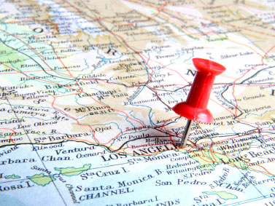
Motivation
Location information is of high importance for various fields
Potentials for
  Understanding users’ movement
  Influence of location in social structure
  Design social network architectures
  Transportation patterns analysis
  Etc.
Can be used in combination with
Open Data

Slide 4

Motivation
Only a small number of users share such information in OSN profiles
Majority in relatively high granularities
    Country level
    State level
    City level

Slide 5
Is it possible to infer a user’s u Home and Workplace locations simply by observing the locations and time the user tweeted from?
  We present a methodology which infers users key locations at post-code level
    With the use of geo-tagged Twitter data
    Evaluation on 3 distinct geographical regions
      Outperforms different studies in cases of granularity and accuracy
      Compare and validate our results with open-data

Slide 6
Related Work
Identification of users’ locations from OSN is in high interest for researchers
Approaches:
  Content-based
    Analysis of the text that users publish
    Their accuracy is at most 57% for 10Km granularity
  Geo-tagged based
    Based on geographical info (latitude, longitude)
    Mainly for “ground truth” construction regarding home locations (Assumed to have 100% accuracy)

Slide 7
Datasets

Slide 8


Datasets
We construct two different datasets
  Home Location Identification
  Workplace Location Identification

Slide 9
Home Location

Slide 10
Home Location
We collect the Twitter Stream from 3 different areas:
  The Netherlands
  London, UK
  Los Angeles County, US
Collected users act as seeders
Randomly collect users with whom they have reciprocal relationship

Slide 11
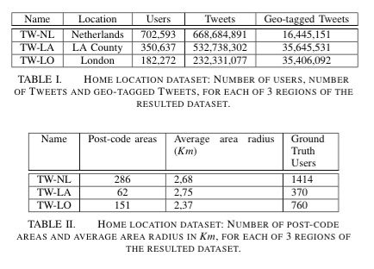
Home Location
Users: ~1 million
Tweets: ~1.5 billion
Geo-tagged: ~6%
Ground truth users: Users who report their exact coordinates (latitude,longitude) or post-code location

Slide 12
Workplace Location

Slide 13
Workplace Location
Work location is not usually clearly stated by a Twitter user in her personal profile
  Profiles are used for a completely different purpose than career-related tools
LinkedIn
  a professional social network
  users publish career related information
    Including the place they work
      City level

Slide 14
Workplace Location
Listen to the public stream of Friendfeed for 1 week
  Aggregator tool
  Resulted to ~20,000 users
Retrieve users who have both
  ~3000 users

Slide 15
Workplace Location
  Problem: Company’s reported location is the headquarters location
  Pre-processing analysis for aggregated profiles
    Identify the exact branch of the company/employer at post-code level
    Identify geo-location information for the workplace of 317 different users from different countries

Slide 16

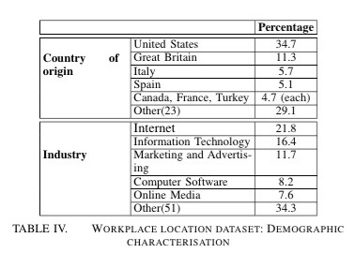
Workplace Location

Slide 17
Users Key Locations
Time-Frame Clustering methodology

Slide 18
Hypothesis
Users tend to spend a significant, but distinct, amount of their time during an average day in two key locations of interest; Home and Work locations
These two locations are much more likely to appear in the user’s geo-tagged activity during specific timeframes, than locations that are not so frequent in users routine.

Slide 19
Observations
Tweets publishing activity during a week
We expect that the user will mostly be posting tweets from a single location during Rest and Active

Slide 20
Observations
Tweeting rate distribution from home on an hourly basis. Y-axis represents the portion of total Tweets that have been produced during a specific hour.
Probability of tweeting from Home tends to increase significantly during (and close to) the Rest timeframe.

Slide 21
Observations
Tweeting rate distribution from workplace on an hourly basis. Y-axis represents the portion of total Tweets that have been produced during a specific hour.
Probability of tweeting from Work tends to increase significantly during (and close to) the Active timeframe.

Slide 22
Observations
Hypothesis verification: The user is much more likely to tweet from her Home location during Rest hours and from her Work location during Active hours.

Slide 23
Observations
Number of different locations from which user tweet during Active hours.
90% of the cases the user will post at max from a handful of locations during Active timeframe.

Slide 24
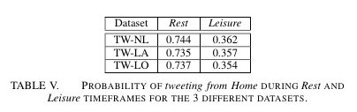
Proposed Methodology
  Each Tweet has a different weight based on:
    Time that has been tweeted
    Location that we aim to extract

Slide 25
Evaluation

Slide 26
Evaluation Scenario
Identify users’ home and workplace locations
  Granularity: Post-code
  Weight timeframes based on observations (e.g. 0.73 rest, 0.26 leisure)
Ground truth
  Users who report their exact location(lat,lon) or post-code in Twitter location field
  Users whom workplace post-code location has been inferred
Comparison with approaches that are used to construct ground truth

Slide 27
Evaluation – Pre-processing
Home identification
  Eliminate common well known locations – POI
    Attractions
    Hotels, restaurants, bars etc.
    Landmarks
Bring all geo-tagged information to a common format
  post-code granularity

Slide 28
Evaluation – Pre-processing
Bring all geo-tagged information to a common format
  Use a geo-coding API to retrieve boundaries of each post-code area
  Map user’s who report exact location in corresponding area

Slide 29
Evaluation - Metrics
ACC - Accuracy: gives the percentage of correctly inferred users’ key locations over the total sample size [1, 2, 3]
ACC@R - Accuracy within radius (R): gives the percentage of correctly inferred users’ key locations identified within R Km from users reported locations [1, 2, 3]
AED - Average Error Distance: defines the distance, in Km, between the inferred location (center of the post-code in our case) and user’s reported location [1, 3]
1. S. Katragadda, M. Jin, and V. Raghavan. An unsupervised approach to identify location based on the content of user’s tweet history. In Active Media Technology 2014
2. J. Mahmud, J. Nichols, and C. Drews. Home location identification of twitter users. ACM Trans. Intell. Syst. Technol. 2014
3. K. Ryoo and S. Moon. Inferring twitter user locations with 10 km accuracy. WWW’14

Slide 30
Evaluation - Methods
MP - Most Popular marks as home location the most popular location, in number of geo-tagged tweets, visited by the user
MC - Median Clustering marks the user’s home location by calculating the median value of location the user tweeted from
TF-C – Time-Frame Clustering is the method presented in our paper

Slide 31
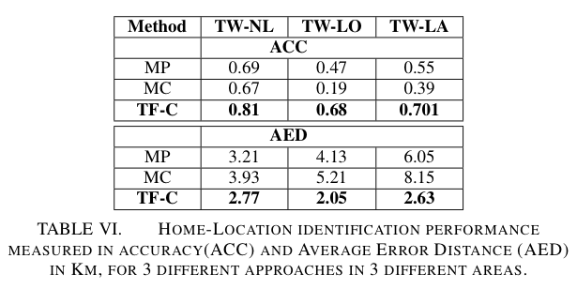
Evaluation - Results
On ground truth data

Slide 32
Evaluation - Results
On ground truth data

Slide 33
Evaluation - Results
Workplace identification
Identify the exact workplace location at 5Km granularity with 76% accuracy.

Slide 34
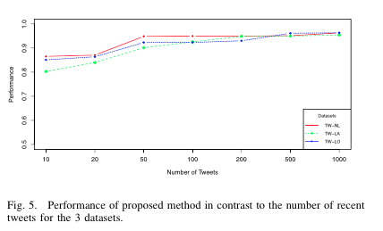
How many Tweets does TF-C require?

Slide 35
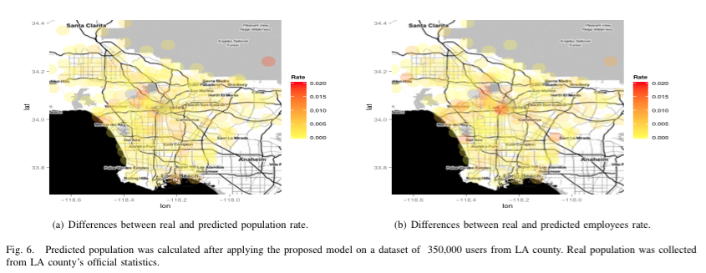
Evaluation - Results
Home and Workplace: On open-data
84% of the areas the predicted and real post-code population rate differ only by 0.005.
>85% of post-code areas the predicted and real employees rate differ by less than 0.005, while only 5% differs by more than 0.01.

Slide 36
Evaluation - Discussion
We can detect a user’s home location in a radius smaller than 10Km in most of the cases
MP and MC
  both methods used to provide ground truth data
  low detection accuracy, between 20 and 70%
We can provide a more accurate ground truth
  Help improve the methods themselves
  and their detection accuracy

Slide 37
Evaluation - Discussion
Workplace location identification
  80% for identification of user workplace in a 10Km proximity.
  First study which constructs a dataset and performs analysis on workplace locations using Twitter

Slide 38
Applications
How can we apply the knowledge of identified locations?

Slide 39
Applications
How are the daily mobility patterns of the users affected by their Home and Work locations?
How is the user Ego network formed based on the location of the user?
How the user’s Home, Work and Leisure locations affect her sentiment?

Slide 40
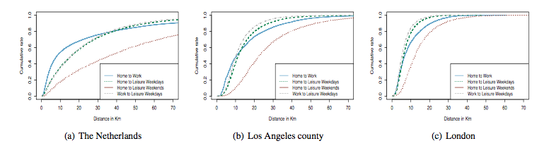
Applications (1)
Home-Work-Leisure proximity: Overall

Slide 41
Applications (1)
Home-Work-Leisure proximity: The Netherlands

Slide 42
Applications (1)
Home-Work-Leisure proximity: LA county

Slide 43
Applications (1)
Home-Work-Leisure proximity: London

Slide 44
Observations: Home - Work
Dutch and LA users tend to choose home further away from work location compared to London Users
  Less than 50% of Dutch and LA users live in less than 10Km from Work
  More than 65% of London users live in less than 10Km from Work
  More than 85% of London users live in less than 20Km from Work
Netherlands: Employees who live in a distance of more than 10Km from Work (in certain areas) are provided with standard allowances
Travel for free during weekdays!

Slide 45
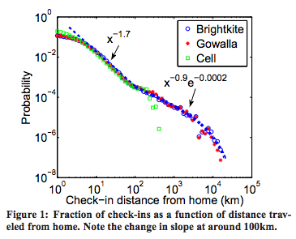
Applications (1)
Fraction of geo-tagged tweets as a function of distance travel from Home
Geo-tagged Tweets distance from Home follows similar distribution as:
  cell phone location data,
  Growalla and
  Brightkite
    check-ins that have been studied from Cho et al. [1]
We also observe a change in the slope of the curve around 100Km.
    1. E. Cho, S. A. Myers, and J. Leskovec. Friendship and mobility: User movement in location-based social networks. KDD’11

Slide 46
Applications
How are the daily mobility patterns of the users affected by their Home and Work locations?
How is the user Ego network formed based on the location of the user?
How the user’s Home, Work and Leisure locations affect her sentiment?

Slide 47
Applications (2)
Look at the distance of the user’s followers from the user’s Home location.
Examine the distance of strong relationships as these can be identified from the reciprocity factor.
Use open data available for the LA county to examine the demographic relationship of the user’s connections.

Slide 48
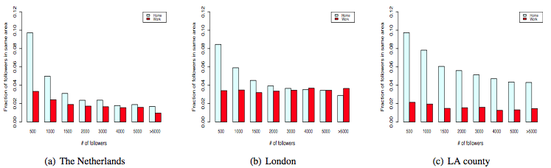
Applications (2)
Fraction of user followers in the same Home location as the user as a function of the user’s total number of followers – Overall
Similar percentage of followers in the same location despite the number of followers of the user.
User’s mostly have a larger number of followers from the same Home location than the same Work location.
  Agree with questionaries’ results of [2]:
    In non-professional social networks a users ego-network contains mostly friends and less colleagues
    2. Alessandro Bozzon, Hariton Efstathiades, Geert-Jan Houben, and Robert-Jan Sips. 2014. A study of the online profile of enterprise users in professional social networks. WWW14

Slide 49
Applications (2)
Fraction of user followers in the same Home location as the user as a function of the user’s total number of followers – The Netherlands

Slide 50
Applications (2)
Fraction of user followers in the same Home location as the user as a function of the user’s total number of followers – LA county

Slide 51
Applications (2)
Fraction of user followers in the same Home location as the user as a function of the user’s total number of followers – London

Slide 52
Applications (2)
The majority of a user’s followers live in close proximity to the user.
  London and LA county:
    >90% of the user’s followers live in <50Km from his Home
  The Netherlands: slightly different approach
    50% of the users followers are in <50Km proximity
    We observe an increase in the number of followers located more than 100Km from the user’s Home location.
Fraction of user followers as a function of the distance from the user’s Home Location

Slide 53
Methodology: Reciprocal Connections
Reciprocity examines whether a connection in a directed graph is bidirectional.
  if a user A follows a user B and user B also follows user A we call this relationship reciprocal
  is often consider as a measure of a stronger connection between two users

Slide 54
Applications (2)
Fraction of reciprocal relationships of a Twitter User as a function of the distance from the user’s Home Location
Most of the reciprocal connections of a user are close to her Home location, in distances less than 50Km
Strengthens the believe that reciprocal connections show a real-world relationship
  most reciprocal relationship are in a proximity that allow face-to-face interaction

Slide 55
Open Data
Examine whether these reciprocal connections belong to the same economic status of the user.
Economic status: the average income salary for the postcode.

Slide 56
Applications (2)
Fraction of reciprocal relationships of a Twitter User as a function of the difference between the average annual salary of the two post-code areas
Most of reciprocal connections tend to live in a postcode with similar average income.
Users not only tend to be friends, in Twitter, with users residing in close proximity
  but also tend to be friends with other users of the same economical status.

Slide 57
Applications
How are the daily mobility patterns of the users affected by their Home and Work locations?
How is the user Ego network formed based on the location of the user?
How the user’s Home, Work and Leisure locations affect her sentiment?

Slide 58
Methodology
Sentiment is commonly used to measure the emotional state of a user based on the text that he publishes
Combined with location information shows
  how different key locations affect the sentiment of the users during their everyday online interactions.

Slide 59
Methodology
Use NLTK to identify sentiment for each English tweet in our dataset
Divide the tweets in three categories, Home, Work and Leisure
  based on the Key locations identified for each user
For each day, we calculate the average score of each user for the corresponding category
For each category, calculate and plot the average score of the specific calendar day
  from January 1st, 2013 to January 1st, 2015

Slide 60
Applications (3)
Sentiment per calendar day for the Tweets published from Home, Work and Leisure locations
Users tend to publish more positive Tweets from Home than from their workplace.
The most positive locations during the whole period of investigation were published from Leisure locations.
“Happy” and “Sad” days can be identified in all timelines, with tweets from Leisure locations being constantly more positive

Slide 61
Future Work

Slide 62
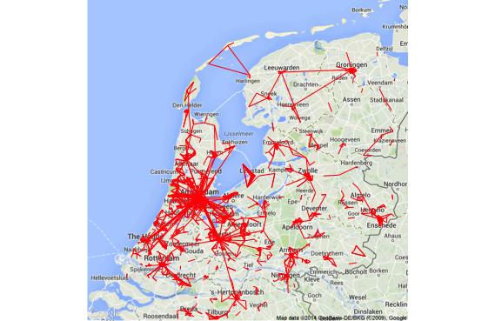
Future Work
Evaluate our observations with ground truth data from cities
Compare mobility patterns inferred by Twitter with ground truth data

Slide 63
Conclusions

Slide 64
Conclusions
Present problem of users location identification from OSN
Present a study on Tweeting activity and users key locations
Propose a methodology for inferring users key locations
  uses geo-tagged twitter data
Evaluation on 3 distinct geographical regions
  Outperforms different studies in cases of granularity and accuracy
Present example applications using enriched knowledge of user’s key locations

Slide 65
Thank You!
Notes:
65
65

